Slide 1
Management & Industrial Establishment
Management: Meaning
Management is a set of activities (including planning and decision making, organizing, leading, and controlling) directed at an organization’s resources (human, financial, physical, and information), with the aim of achieving organizational goals in an efficient and effective manner.
Manager
A manager is someone whose primary responsibility is to carry out the management process. In particular, a manager is someone who plans and makes decisions, organizes, leads, and controls human, financial, physical, and information resources.

Slide 2
Management & Industrial Establishment
The Management Process
Management involves four basic functions of planning and decision making, organizing, leading, and controlling. Let consider the management process of Google. Sergey Brin and Larry Page, Google’s founders and top managers, must first create goals and plans that articulate what they want the company to become. Then they rely on effective organization to help make those goals and plans reality. Brin and Page also pay close attention to the people who work for the company. And they keep a close eye on how well the company is performing. However, the basic management processes are in details as follows:

Slide 3
Management & Industrial Establishment
The Management Process
Planning and decision making: determining courses of action
Organizing: coordinating activities and resources
Leading: motivating and managing people
Controlling: monitoring and evaluating activities

Slide 4
Management & Industrial Establishment
Kinds of Managers: Levels
Top managers
Middle managers
First-line managers

Slide 5
Management & Industrial Establishment
Managing in Different Areas of Organization
Marketing Managers
Financial Managers
Operation Managers
Human Resource Management
Administrative Managers

Slide 6
Management Theories; The Human Relations Movement
Human relations movement argued that workers respond primarily to the social context of the workplace, including social conditioning group norms, and interpersonal dynamics. A basic assumption of the human relations movement was that the manager’s concern for workers would lead to increased satisfaction, which would in turn result in improved performance.
However, it is Maslow who advanced a theory in 1943 suggesting that people are motivated by a hierarchy of needs, including monetary incentive and social acceptance. Maslow’s hierarchy is, perhaps the best-known human relations theory over the years.

Slide 7
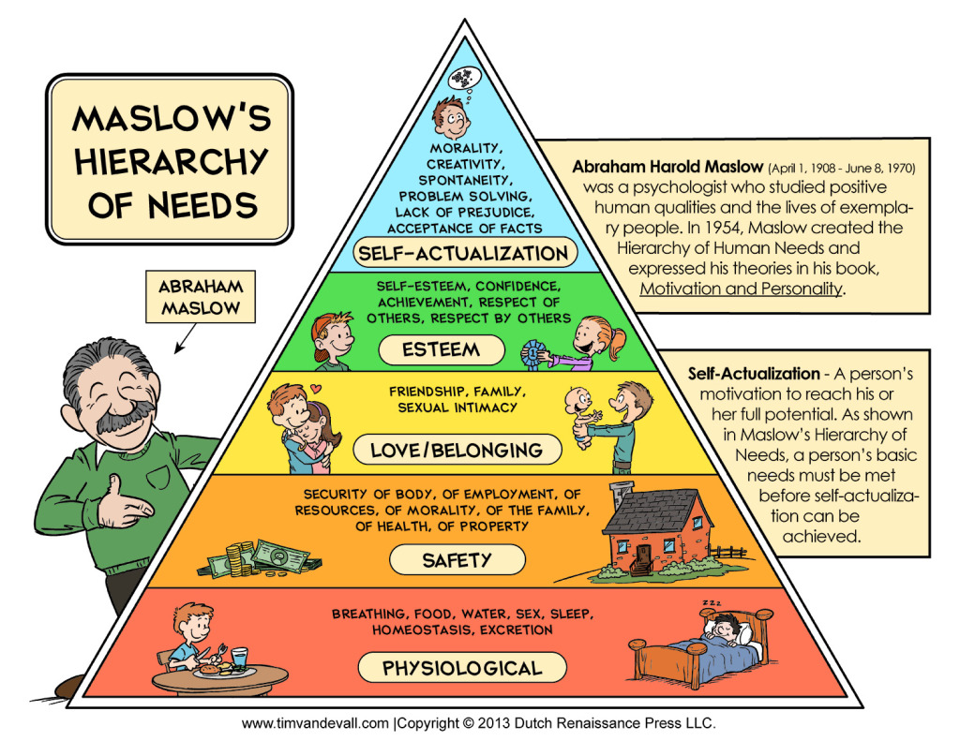
MASLOW’S HIERARCHY OF NEEDS

Slide 8
Management Theories; The Human Relations Movement
Meanwhile, Douglas McGregor’s Theory X and Theory Y model best represents the essence of the human relations movement. According to McGregor, Theory X and Theory Y reflect two extreme belief sets that different managers have about their workers. Theory X is a relatively pessimistic and negative view of workers and is consistent with the views of scientific management. Theory Y is more positive and represents the assumptions that human relations advocates make. In McGregor’s view, Theory Y was a more appropriate philosophy for managers to adhere to.

Slide 9
Management Theories; The Human Relations Movement
Theory X Assumptions:
People do not like to work and try to avoid it
People do not like work, so managers have to control, direct, coerce, and threaten employees to get them to work toward organizational goals.
People prefer to be directed, to avoid responsibility, and to want security; they have little ambition.

Slide 10
Management Theories; The Human Relations Movement
Theory Y Assumptions:
People do not naturally dislike work; work is a natural part of their lives
People are internally motivated to reach objectives to which they are committed
People are committed to goals to the degree that they receive personal rewards when they reach their objectives
People will both seek accept responsibility under favorable conditions
People have the capacity to be innovative in solving organizational problems
People are bright, but under most organizational conditions their potential is underutilized.

Slide 11
Universal principle of management
Fayol’s General Principles of Management:
Division of work
Authority and responsibility
Discipline
Unity of command
Unity of direction
Subordination of individual interest to general interest
Remuneration
Centralization
Scalar chain or line of authority
Order
Equity
Stability of tenure of personnel
Initiative
Esprit de corps

